Slide 1


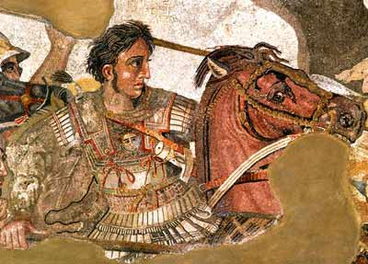

Slide 2
To fully understand Alexander we should have at least a basic knowledge of where the information came from.
What we know is what other people wrote
This writing can be biased or inaccurate
We can decide how reliable it is as a historical source if we know the source of our information

Slide 3

Primary Sources- the lost Works
Alexander was famous- even in his day. Many of his contemporaries wrote about Alex and his exploits. These are our PRIMARY sources.
Unfortunately, these works have not withstood the test of time and are lost to us.
There are 7 men who were ‘primary sources.’

Slide 4
Primary Sources included:
NOTE: Info from ESA study guide.
Historians:
  Callisthenes- Alexander’s official Greek historian and nephew. Employed by Alexander to record events as they happen.
  Cleitarchus- Greek contemporary of Alexander. Did not accompany Alexander on his journey to the east yet produced the most popular account- sensationalised events.

Slide 5
Primary Sources included:
Literary Writers:
  Ptolemy- a Macedonian. One of Alexander’s close friends and chief generals. Wrote an invaluable account of military operations. His treatment of leading men in Alexander’s army is untrustworthy- glorified his own achievements and minimised achievements of others.
  Nearchus- a Greek. Close friend of Alexander. Became admiral. Accompanied the expedition and sailed the coast of Persia. Wrote only about the voyage of the fleet.

Slide 6
Primary Sources included:
(Literary writers continued):
  Onesecritus- Greek sailor on the expedition. Wrote a historical romance. Writings are unreliable.
  Aristobulus- Macedonian soldier and engineer who accompanied Alexander on the expedition to the east. Wrote when he was an old man. Work invaluable for geographical information and for detailed account of Alexander’s last year.
  Chares- Alexander’s Greek chamberlain in charge of his household. Wrote brief account of Alexander’s progress. As an eye witness is important for detailing some incidents, e.g. Alex’s efforts to introduce proskynesis.

Slide 7
Secondary Sources
All the histories we have today of Alexander were written many years after his death
These ‘secondary sources’ got their information from the primary sources
They may also be biased:
  - what is the point of view of the historian?
  - how subjective was he regarding the information he was collecting?
  - why was he writing his history of Alexander?

Slide 8
The Secondary Sources
There are 5 main secondary sources:
Arrian – wrote the Anabasis around 140-150 AD. He relied on earlier writings, particularly of Ptolemy and Aristobulous. He wrote with a desire for interest and striking detail, as long as it wasn’t wildly unreliable.
This tells us that Arrian had less concern for the truth, and wanted interesting stories.

Slide 9
Plutarch – wrote about Alexander around 105-115AD. He compared the lives of famous ancient men, such as Alexander the Great and Julius Caesar. His writing contains interesting anecdotes, which may or may not be true. He provides the reader with examples of political and moral virtue.
He refers to primary sources Callisthenes and Cleitarchus.

Slide 10
Diodorus Siculus – wrote a Universal History around 60-30 BC. He based his work on primary sources Aristobulous, and some other unidentified sources.

Slide 11
Curtius Rufus – wrote a history of Alexander in 10 books (but not all remain today) around 60-70AD. It seems he used the same source as Diodorus.
His writing is dramatic and emotional, with vivid detail. There are some speeches added in his writing, too.

Slide 12
Justin – wrote in the time of Augustus, around 60-30 BC.
Not thought to be as reliable as Arrian, Plutarch or Diodorus.

